Slide 1
IEEE 802.15.4 Wireless Sensor Network
Yao-Tung Tsou

Slide 2

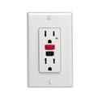


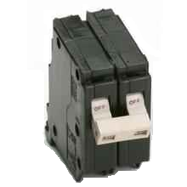
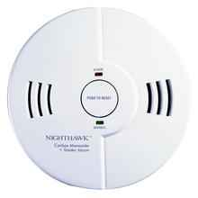
IEEE 802.15.4 Applications Space
Home Networking
Automotive Networks
Industrial Networks
Interactive Toys
Remote Metering

Slide 3




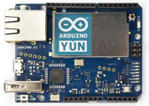



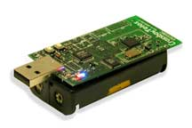

Some needs in the sensor networks
End-user
Core network
e.g. Internet
Gateway
Computer services
Sink node
Sensor node
Gateway
The networks typically run Low Power Devices
Consist of one or more sensors, could be different type of sensors
Use wireless communication protocols such as IEEE 802.15.4
Operate at 2.4 GHz and 250KB/s data rates

Slide 4
802.15.4 General Characteristics
Data rates of 250 kb/s, 40 kb/s and 20 kb/s.
Star or Peer-to-Peer operation.
Support for low latency devices.
Fully hand-shaked protocol for transfer reliability.
Low power consumption.
Frequency Bands of Operation
16 channels in the 2.4GHz ISM* band
10 channels in the 915MHz ISM band
1 channel in the European 868MHz band.

Slide 5
802.15.4 / ZigBee Architecture
Applications
ZigBee
IEEE 802.15.4 MAC
Packet generation
Packet reception
Data transparency
Power Management
IEEE 802.15.4
IEEE 802.15.4
868/915 MHz
2400 MHz
PHY
PHY

Slide 6
IEEE 802.15.4 PHY Overview Operating Frequency Bands
Channel 0
Channels 1-10
868MHz / 915MHz
PHY
2 MHz
868.3 MHz
902 MHz
928 MHz
2.4 GHz
PHY
Channels 11-26
5 MHz
2.4 GHz
2.4835 GHz

Slide 7
IEEE 802.15.4 PHY Overview Packet Structure
PHY Packet Fields
Preamble (32 bits) – synchronization
Start of Packet Delimiter (8 bits)
PHY Header (8 bits) – PSDU length
PSDU (0 to 1016 bits) – Data field
Start of
Packet
Delimiter
PHY
Header
PHY Service
Data Unit (PSDU)
Preamble
6 Octets
0-127 Octets

Slide 8
802.15.4 Architecture
Applications
ZigBee
Channel acquisition
Contention mgt
NIC address
Error Correction
IEEE 802.15.4 MAC
IEEE 802.15.4
IEEE 802.15.4
868/915 MHz
2400 MHz
PHY
PHY

Slide 9
IEEE 802.15.4 MAC Overview Design Drivers
Extremely low cost
Ease of implementation
Reliable data transfer
Short range operation
Very low power consumption
Simple but flexible protocol

Slide 10



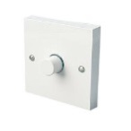


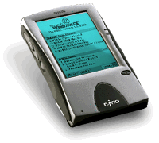
IEEE 802.15.4 MAC Overview Typical Network Topologies

Slide 11
IEEE 802.15.4 MAC Overview Device Classes
Full function device (FFD)
Any topology
Network coordinator capable
Talks to any other device
Reduced function device (RFD)
Limited to star topology
Cannot become a network coordinator
Talks only to a network coordinator
Very simple implementation

Slide 12
IEEE 802.15.4 MAC Overview Star Topology
PAN
Coordinator
Master/slave
Full function device
Communications flow
Reduced function device

Slide 13
IEEE 802.15.4 MAC Overview Peer-Peer Topology
Point to point
Cluster tree
Full function device
Communications flow

Slide 14
IEEE 802.15.4 MAC Overview Combined Topology
Clustered stars - for example,
cluster nodes exist between rooms
of a hotel and each room has a
star network for control.
Communications flow
Full function device
Reduced function device

Slide 15
IEEE 802.15.4 MAC Overview General Frame Structure

Slide 16
IEEE 802.15.4 MAC Overview Traffic Types
Periodic data
Application defined rate (e.g. sensors)
Intermittent data
Application/external stimulus defined rate (e.g. light switch)
Repetitive low latency data
Allocation of time slots (e.g. mouse)

Slide 17
802.15.4 Architecture
Applications
Network Routing
Address translation
Packet Segmentation
Profiles
ZigBee
IEEE 802.15.4 MAC
IEEE 802.15.4
IEEE 802.15.4
868/915 MHz
2400 MHz
PHY
PHY

Slide 18
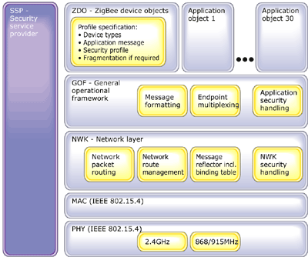
ZigBee Stack Architecture

Slide 19
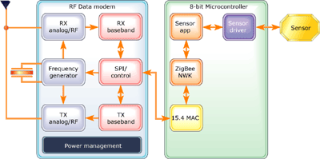
Typical ZigBee-Enabled Device Design
Typical design consist of RF IC and 8-bit microprocessor with peripherals connected to an application sensor or actuators

Slide 20
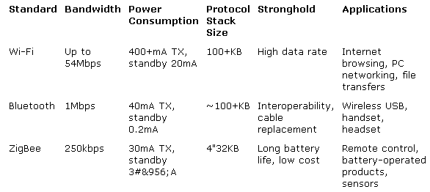
Wireless Technology Comparison Chart

Slide 21

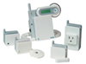

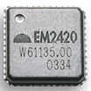
802.15.4/ZigBee Products
Control for Home Automation System
http://www.control4.com/products/components/complete.htm
Eaton Home HeartBeat monitoring system
www.homeheartbeat.com
Software, Development Kits
AirBee, http://www.airbeewireless.com/products.php
Software Technologies Group, http://www.stg.com/wireless/
Chip Sets
Ember, http://www.ember.com/index.html
ChipCon, http://www.chipcon.com
Freescale, http://www.freescale.com

Slide 22
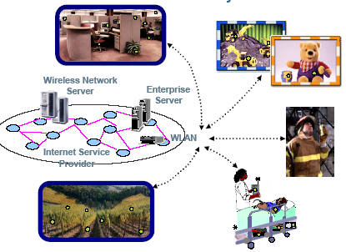
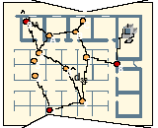
Motorola Activity
Implementation of 802.15.4 & ZigBee
Aimed at enterprises
Asset Tracking
Security
Public Safety
Range: 10m
Transmission interval: ~ 4 minutes
Nodes move, Controller does not
Battery life: 1 week to several years (nodes with 2 AA batteries)
Interfaces: machine-only

Slide 23
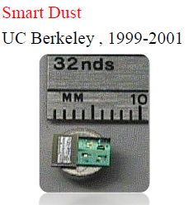


Sensor Platforms
Sensor node/Mote: Small cache, low-speed CPU, wireless interface for transmission, battery, possibly with location information
Sink node/Gateway: gather data from sensor nodes and forward gathered data to end-users.
UC Berkeley, Smart Dust

Slide 24
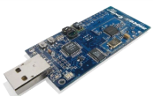

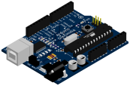

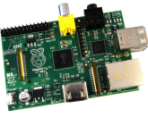

Sensor Platforms
Popular Sensor Platforms
NTU
Simple node / Super node / Taroko
NTHU
Octopus II / Octopus X
NCTU
Eco node
UC Berkeley
Tmote Sky
M. Banzi et. al.
Arduino
Raspberry Pi Foundation
Raspberry Pi

Slide 25
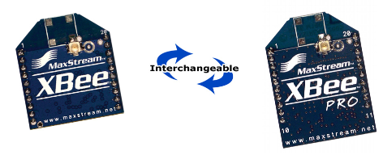
Xbee / Xbee Pro

Slide 26
XBee/XBee ‐ PRO RF Modules
The XBee and XBee-PRO RF Modules were engineered to meet IEEE 802.15.4 standards and support the unique needs of low-cost, low-power wireless sensor networks.
The modules require minimal power and provide reliable delivery of data between devices.
The modules operate within the ISM 2.4 GHz frequency band and are pin-for-pin compatible with each other.

Slide 27
Long Range Data Integrity
XBee
• Indoor/Urban: up to 100’ (30 m)
• Outdoor line-of-sight: up to 300’ (90 m)
• Transmit Power: 1 mW (0 dBm)
• Receiver Sensitivity: -92 dBm
XBee-PRO
• Indoor/Urban: up to 300’ (90 m), 200' (60 m) for International variant
• Outdoor line-of-sight: up to 1 mile (1600 m), 2500' (750 m) for International variant
• Transmit Power: 63mW (18dBm), 10mW (10dBm) for International variant
• Receiver Sensitivity: -100 dBm
RF Data Rate: 250,000 bps

Slide 28
Low Power
XBee
• TX Peak Current: 45 mA (@3.3 V)
• RX Current: 50 mA (@3.3 V)
• Power-down Current: < 10 μA
XBee-PRO
• TX Peak Current: 250mA (150mA for international variant)
• TX Peak Current (RPSMA module only): 340mA (180mA for international variant
• RX Current: 55 mA (@3.3 V)
• Power-down Current: < 10 μA

Slide 29
Xbee / Xbee Pro

Slide 30
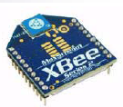
XBee
This is the new 2.4GHz XBee module from Digi. These modules take the 802.15.4 stack (the basis for Zigbee) and wrap it into a simple to use serial command set.
250kbps Max data rate
400ft (120m) range
6 10-bit ADC input pins and 8 digital IO pins
128-bit encryption
Local or over-air configuration

Slide 31
XBee/XBee ‐ PRO RF Modules
The XBee and XBee-PRO RF Modules were engineered to meet IEEE 802.15.4 standards and support the unique needs of low-cost, low-power wireless sensor networks.
The modules require minimal power and provide reliable delivery of data between devices.
The modules operate within the ISM 2.4 GHz frequency band and are pin-for-pin compatible with each other.

Slide 32
Long Range Data Integrity
XBee
• Indoor/Urban: up to 30 m
• Outdoor line-of-sight: up to 90 m
• Transmit Power: 1 mW (0 dBm)
• Receiver Sensitivity: -92 dBm
XBee-PRO
• Indoor/Urban: up to 90 m
• Outdoor line-of-sight: up to 1600 m
• Transmit Power: 63mW (18dBm)
• Receiver Sensitivity: -100 dBm
RF Data Rate: 250,000 bps

Slide 33
Low Power
XBee
• TX Peak Current: 45 mA (@3.3 V)
• RX Current: 50 mA (@3.3 V)
• Power-down Current: < 10 μA
XBee-PRO
• TX Peak Current: 250mA
• RX Current: 55 mA (@3.3 V)
• Power-down Current: < 10 μA

Slide 34
ADC and I/O line support
Analog-to-digital conversion, Digital I/O Line Passing

Slide 35
Easy-to-Use
No configuration necessary for out-of- box RF communications
Free X-CTU Software (Testing and configuration software)
AT and API Command Modes for configuring module parameters
Extensive command set

Slide 36
AT vs API
In AT Command mode(Transparent Mode) , everything got in RX of XBee will be sent out via antenna , the incoming data from antenna will go to TX. But in API Mode , it won't send out anything until it received the correct form of commands from serial interface.

Slide 37
API
The API allows the programmer the ability to:
Change parameters without entering command mode
View RSSI and source address on a packet by packet basis
Receive packet delivery confirmation on every transmitted packet

Slide 38
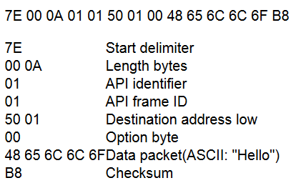
API

Slide 39
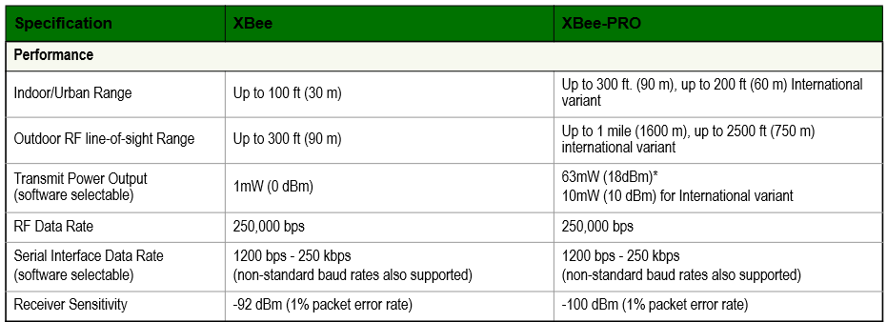
Specifications

Slide 40
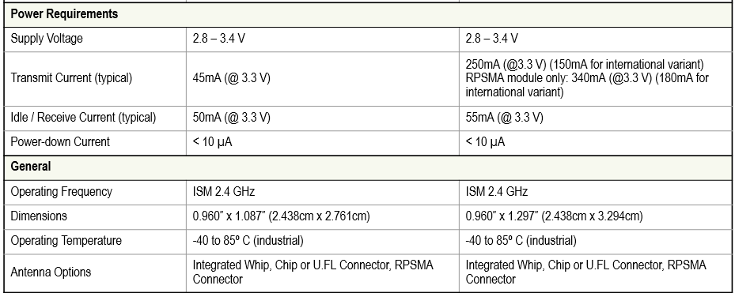
Specifications

Slide 41
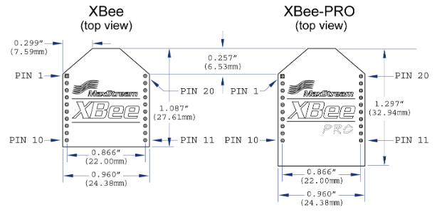
Mechanical Drawings

Slide 42
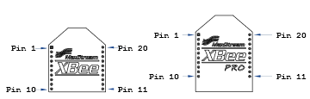
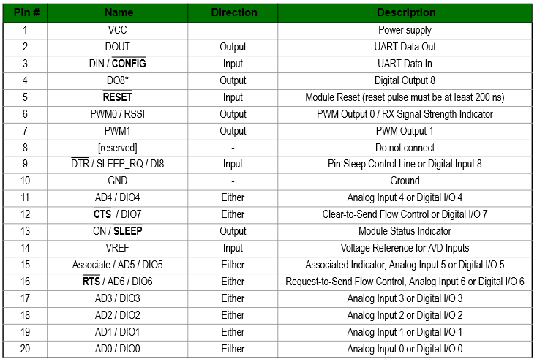
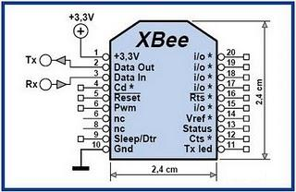
Pin Signals

Slide 43
RF Module Operation
Serial Communications
The XBee/XBee-PRO RF Modules interface to a host device through a logic-level asynchronous serial port.
Through its serial port, the module can communicate with any logic and voltage compatible UART.
Or through a level translator to any serial device (For example: Through a RS-232 or USB interface board).

Slide 44
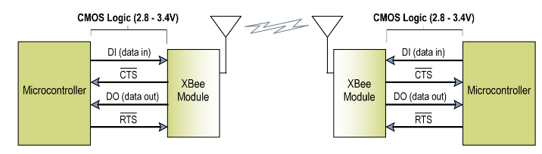
UART Data Flow

Slide 45
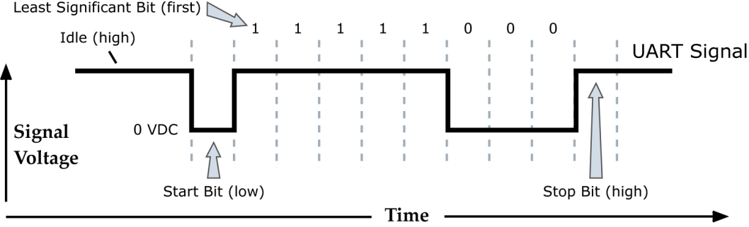
Serial Data
Data enters the module UART through the DI pin (pin 3) as an asynchronous serial signal.
The signal should idle high when no data is being transmitted.
Each data byte consists of a start bit (low), 8 data bits (least significant bit first) and a stop bit (high).
The following figure illustrates the serial bit pattern of data passing through the module.

Slide 46
Serial Data
Serial communications depend on the two UARTs (the microcontroller's and the RF module's) to be configured with compatible settings (baud rate, parity, start bits, stop bits, data bits).
The UART baud rate and parity settings on the XBee module can be configured with the BD and SB commands, respectively.

Slide 47
Transparent Operation
By default, XBee/XBee-PRO RF Modules operate in Transparent Mode.
When operating in this mode, the modules act as a serial line replacement
all UART data received through the DI pin is queued up for RF transmission. When RF data is received, the data is sent out the DO pin.

Slide 48
Serial-to-RF Packetization
Data is buffered in the DI buffer until one of the following causes the data to be packetized and transmitted:
No serial characters are received for the amount of time determined by the RO (Packetization Timeout) parameter.
If RO = 0, packetization begins when a character is received.
The maximum number of characters that will fit in an RF packet (100) is received.
The Command Mode Sequence (GT + CC + CT) is received.
Any character buffered in the DI buffer before the sequence is transmitted

Slide 49
Serial-to-RF Packetization
If the module cannot immediately transmit (for instance, if it is already receiving RF data), the serial data is stored in the DI Buffer. The data is packetized and sent at any RO timeout or when 100 bytes (maximum packet size) are received.
If the DI buffer becomes full, hardware or software flow control must be implemented in order to prevent overflow (loss of data between the host and module).

Slide 50
API Operation
API (Application Programming Interface) Operation is an alternative to the default Transparent Operation.
The frame-based API extends the level to which a host application can interact with the networking capabilities of the module.
When in API mode, all data entering and leaving the module is contained in frames that define operations or events within the module.

Slide 51
API Operation
Transmit Data Frames (received through the DI pin (pin 3)) include:
RF Transmit Data Frame
Command Frame (equivalent to AT commands)
Receive Data Frames (sent out the DO pin (pin 2)) include:
RF-received data frame
Command response
Event notifications such as reset, associate, disassociate, etc.

Slide 52
API Operation
The API provides alternative means of configuring modules and routing data at the host application layer.
A host application can send data frames to the module that contain address and payload information instead of using command mode to modify addresses.
The module will send data frames to the application containing status packets; as well as source, RSSI and payload information from received data packets.

Slide 53
API Operation
The API operation option facilitates many operations such as the examples cited below:
-> Transmitting data to multiple destinations without entering Command Mode
-> Receive success/failure status of each transmitted RF packet
-> Identify the source address of each received packet

Slide 54
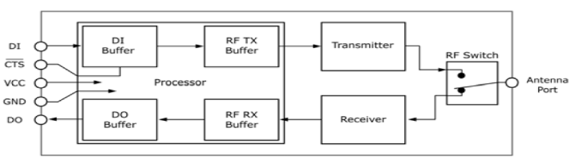
Flow Control

Slide 55
Implementation

Slide 56
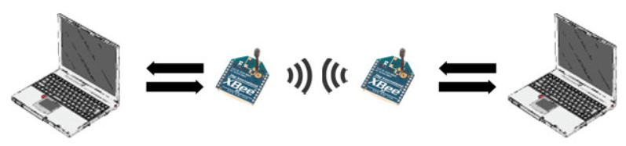
Introduction
This basic chat tutorial shows you how to get wireless text chat going between two computers using Digi’s XBee 802.15.4 Wireless Modules (formerly called XBee Series 2). Using a serial connection from your computer, the text you type to one XBee will be wirelessly transmitted to the other XBee, which will send the text via serial to your other computer.

Slide 57
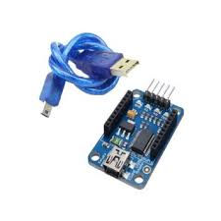
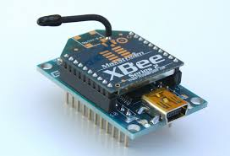
Assemble the Parts
2 XBee 802.15.4 Radios (Series 2)
2 XBee usb adapter
2 Two computers, each running a serial terminal program, or one computer running two different serial terminal programs.

Slide 58
Step 1: Download X-CTU Software
The X-CTU software is free to download and provides a simple interface to configure and update your XBee transceivers. With this software firmware updates are a breeze and configuration is simple. The software can be downloaded from Digi's website found:
http://www.digi.com/products/xbee-rf-solutions/xctu-software/xctu

Slide 59
Step 2: Connection
Adapter allows for connection through usb or serial to your computer.
Use X-CTU to configure your Xbee.

Slide 60
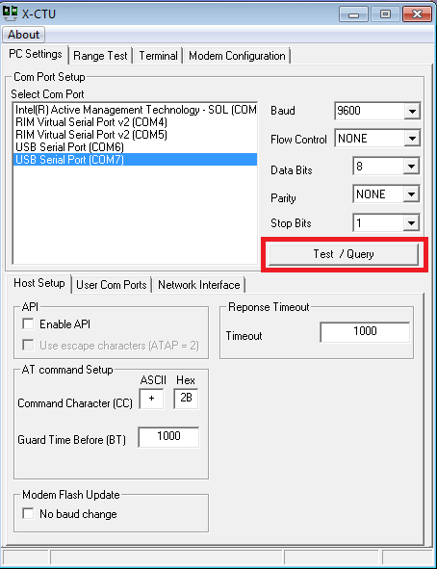
Step 3: Configure 1st XBee as a coordinator
When opening the X-CTU software you should see a window like that shown. After selecting the proper COM port click the Test/Query button.

Slide 61
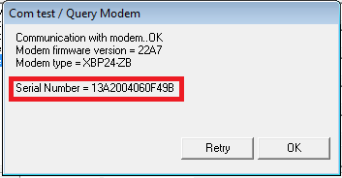
Step 3: Configure 1st XBee as a coordinator
After selecting the Test/Query button, you should see a dialogue box like the one below. You will want to record the serial number shown as you will need it in a couple minutes.

Slide 62
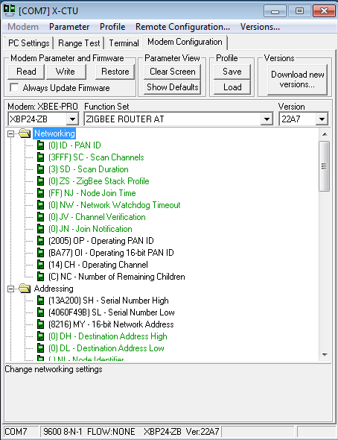
Step 3: Configure 1st XBee as a coordinator
After recording the serial number you can click OK. Next, select the Modem Configuration tab at the top of the window. Once here, select the read button. This will bring up the current configuration for the connected XBee and will be similar to the following:

Slide 63
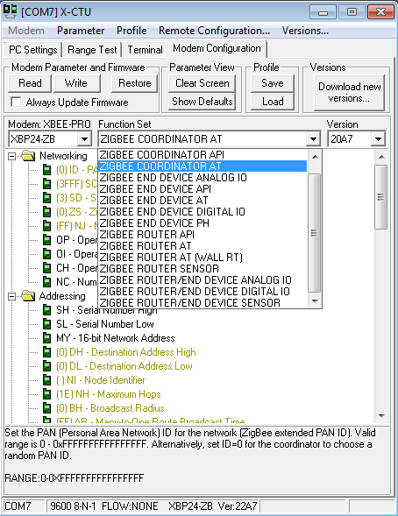
Step 3: Configure 1st XBee as a coordinator
Once here, you want to select Zigbee Coordinator AT in the function set drop down menu.

Slide 64
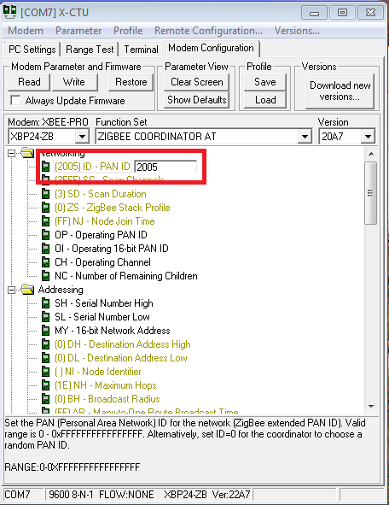
Step 3: Configure 1st XBee as a coordinator
After selecting the coordinator function set, you will need to set the PAN ID. This can be any four digit number and allows the XBees to distinguish between modules in their network and those from other networks. Once you have added the wanted PAN ID click the "Write" button. This will update and configure the XBee. Once this is done you can disconnect the XBee and plug in the second XBee.

Slide 65
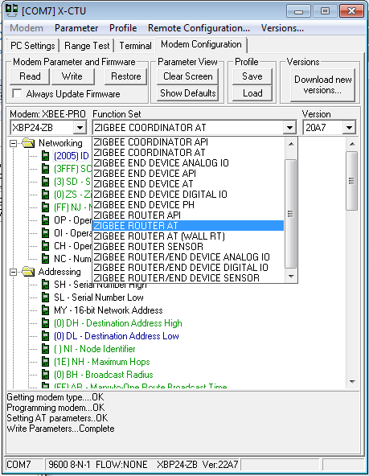
Step 4: Configure 2nd XBee as Router
To configure the 2nd XBee, you will follow the same process as for the coordinator with one difference. In the PC settings tab, again, click the "Test/Query" button and record the serial number. Then in the Modem configuration tab, click the read button to load the current configuration of the XBee and set the PAN ID to the same ID used for the coordinator. The only change will be the function set you choose. For the second XBee we will set this as Zigbee Router AT.

Slide 66
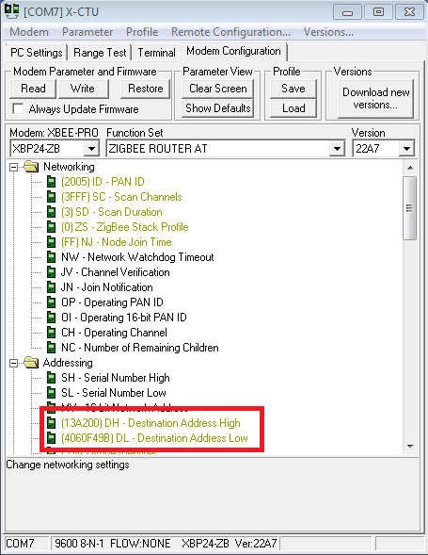
Step 4: Configure 2nd XBee as Router
After setting the PAN ID and the function set for the router you will put the recorded serial numbers to use. Enter the first 6 digits of the coordinators serial number into the Destination Address High field and the rest of the serial number into the Destination Address Low field. Then select the "Write" button to update the configuration settings for the router. Once this is done updating you can disconnect the router and reconnect the coordinator to the computer.

Slide 67
Step 4: Configure 2nd XBee as Router
After re-connecting the coordinator to the computer. You will again go into the Modem Configuration tab and click the read button. You will then want to set the Destination Address to the serial number of the Router XBee in the same manner as you just did for the Router.
Once done you will again click the write button to update the coordinator XBee settings. After the write process is complete you are ready to use your XBees and communicate wirelessly!

Slide 68
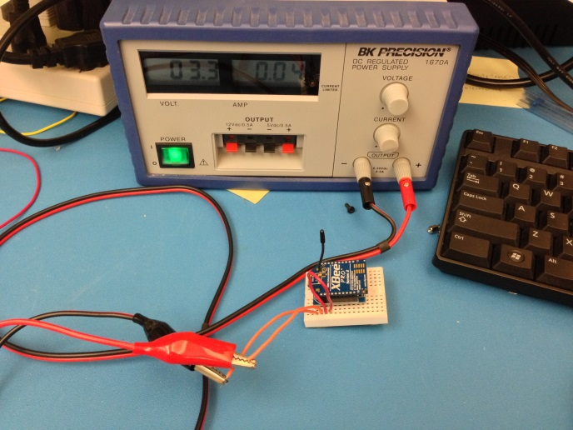
Step 5: Test the configuration
A simple test can be done to be sure the two XBees are communicating properly. You can connect either one of the XBees to the computer. Then, connect the second XBee to 3.3V power and connect the Dout and Din pins together. This will cause the XBee to automatically retransmit any data it receives.

Slide 69
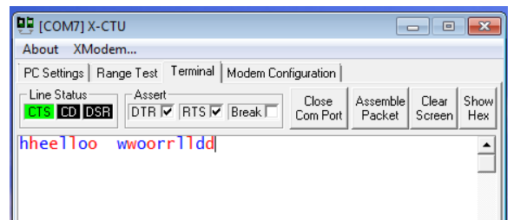
Step 5: Test the configuration
When you have both XBees connected go to the Terminal tab in the X-CTU window. Whatever you type in the terminal window will appear in blue font and whatever is received will appear in red font. If the XBees are configured correctly every character you type should be mirrored in red.

Slide 70
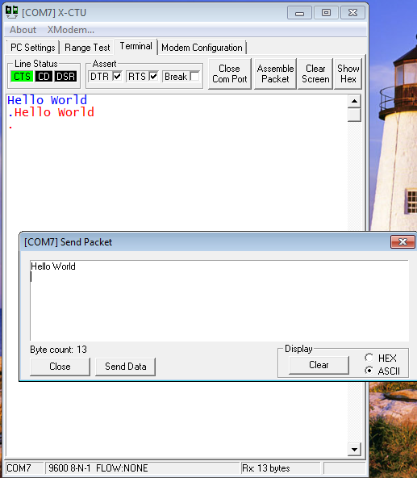
Step 5: Test the configuration
When typing single characters, you should see a screen similar to the one above. To send strings of data you can assemble a data packet. To do this click the "Assemble Packet" button and type the wanted string into the box then click send data. This will send the entire packet before receiving the same packet back.

Slide 71
Lab: Sending temperature data via XBee

Slide 72
Sending temperature data via XBee
Connecting LM35 to Pi A and sending temperature data to Pi B through Xbee module
Setting one is coordinator and the other is endpoint/router

Slide 73
Open serial port
“serial” module is required.
Open serial port
serial.serial(‘/dev/ttyUSB0’, [baud rate])
Check ComPort
object.isOpen()
object.name

Slide 74
Serial write and read
Serial write
object.write([data])
Serial read
object.readline()

Slide 75
Using thread
Evaluating thread funtion
“threading” module is required
threading.Thread(target=[function name], args=(ser, ))

Slide 76
End

